Slide 1
Transmission Media
Chapter-7

Slide 2
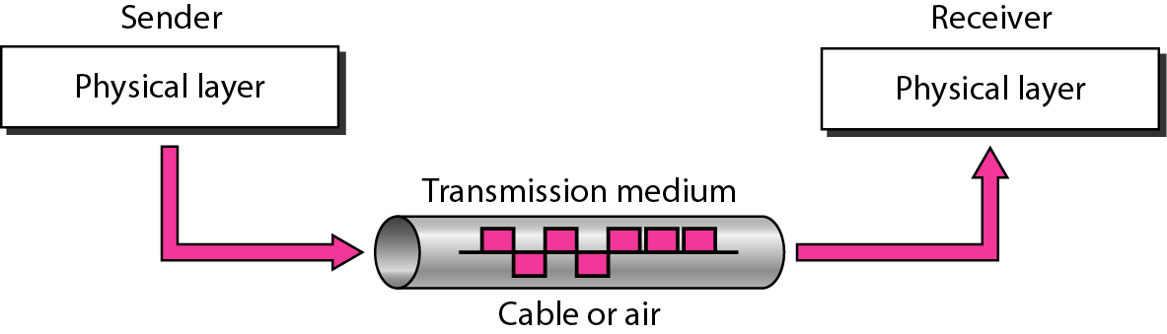
Transmission Medium
A transmission medium can be broadly defined as anything that can carry information from a source to a destination.

Slide 3
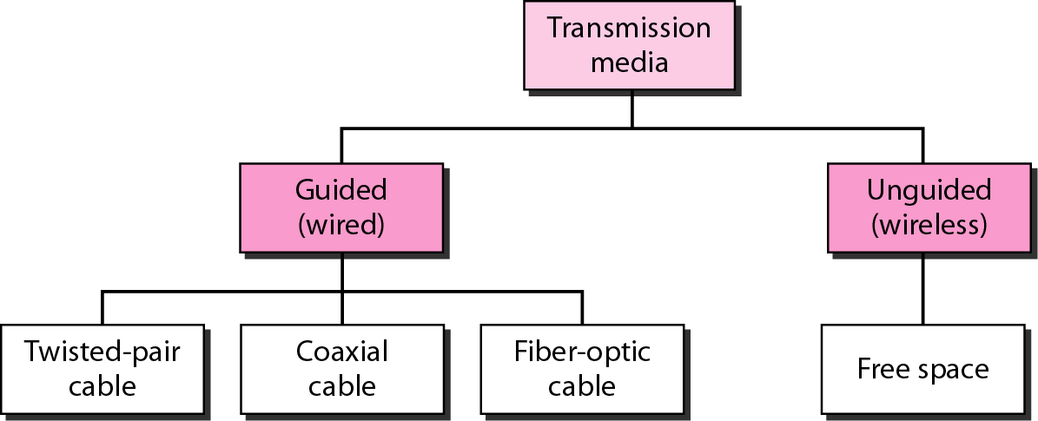
Classes of Transmission Medium

Slide 4
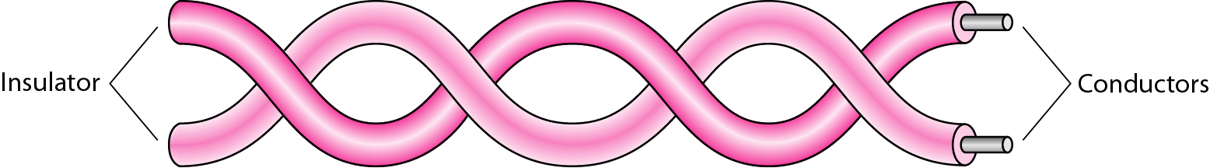
Twisted Pair Cable
A twisted pair consists of two conductors (normally copper), each with its own plastic insulation, twisted together.
One of the wires is used to carry signals to the receiver, and the other is used only as a ground reference.
The receiver uses the difference between the two.
In addition to the signal sent by the sender on one of the wires, interference (noise) and crosstalk may affect both wires and create unwanted signals.

Slide 5
Twisted Pair Cable
If the two wires are parallel, the effect of these unwanted signals is not the same in both wires because they are at different locations relative to the noise or crosstalk sources (one is closer and the other is farther).
By twisting the pairs, a balance is maintained. For example, suppose in one twist, one wire is closer to the noise source and the other is farther; in the next twist, the reverse is true.
Twisting makes it probable that both wires are equally affected by external influences (noise or crosstalk). This means that the receiver, which calculates the difference between the two, receives no unwanted signals. The unwanted signals are mostly canceled out.

Slide 6
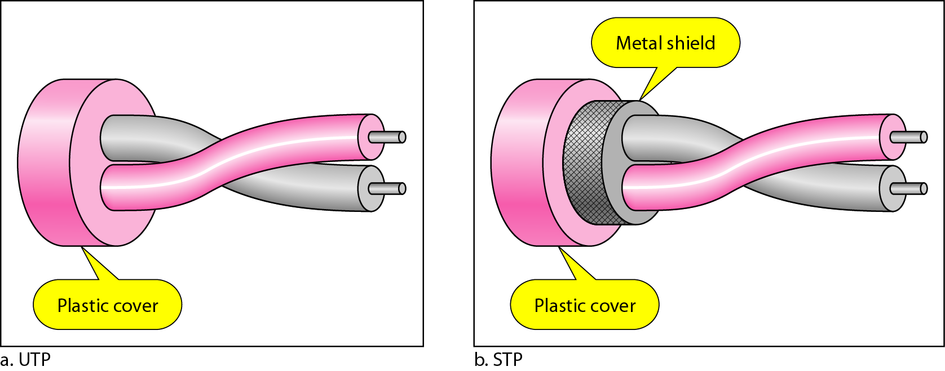
Types of Twisted Pair Cable

Slide 7
Shielded Twisted Pair Cable (STP)
STP cable has a metal foil or braided mesh covering that encases each pair of insulated conductors.
Advantages
Eliminates crosstalk.
Better performance at a higher rate in comparison to UTP.
Disadvantages
Bulky.
More expensive.
Comparatively difficult to manufacture and install.

Slide 8
Unshielded Twisted Pair Cable (UTP)
Advantages
Least Expensive.
Easy to install.
High speed capacity.
Disadvantages
Susceptible to external interference.
Lower capacity and performance in comparison to STP.
Short distance transmission due to attenuation.

Slide 9
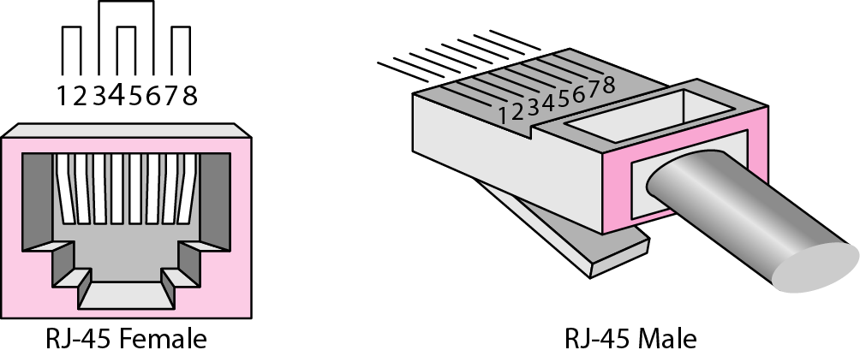
UTP Connector

Slide 10
Uses of Twisted Pair Cable
Twisted-pair cables are used in telephone lines to provide voice and data channels.
The local loop-the line that connects subscribers to the central telephone office commonly consists of unshielded twisted-pair cables.
The DSL lines that are used by the telephone companies to provide high-data rate connections also use the high-bandwidth capability of unshielded twisted-pair cables.
Local-area networks, such as l0Base-T and l00Base-T, also use twisted-pair cables.

Slide 11
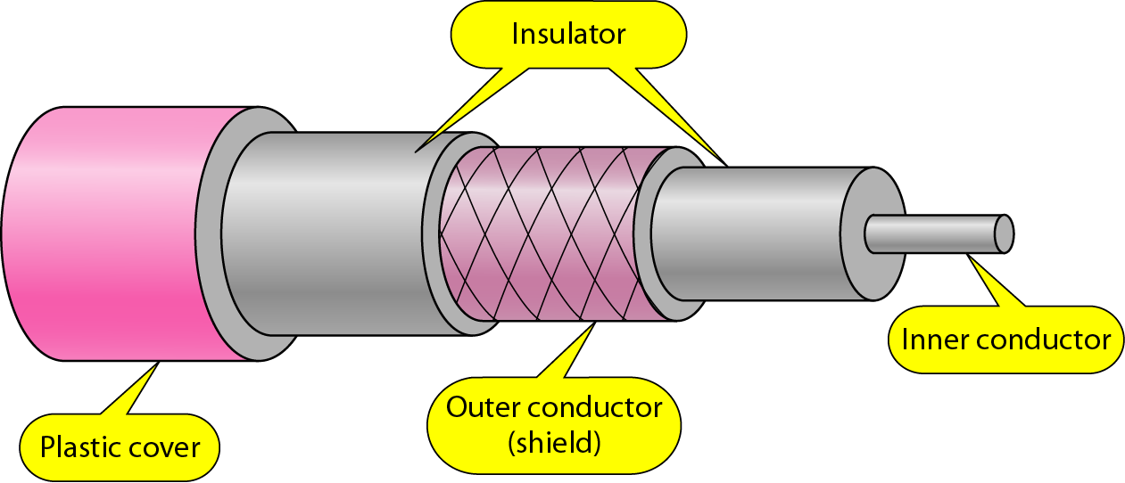
Coaxial Cable
Coaxial cable (or coax) carries signals of higher frequency ranges than those in twisted pair cable.
It has a central core conductor of solid or stranded wire (usually copper) enclosed in an insulating sheath, which is, in turn, encased in an outer conductor of metal foil, braid, or a combination of the two.
The outer metallic wrapping serves both as a shield against noise and as the second conductor, which completes the circuit.
This outer conductor is also enclosed in an insulating sheath, and the whole cable is protected by a plastic cover.

Slide 12
Coaxial Cable
Advantages
High bandwidth.
Better noise immunity.
Easy to install.
Inexpensive.
Disadvantages
Single cable failure can disrupt the network.

Slide 13
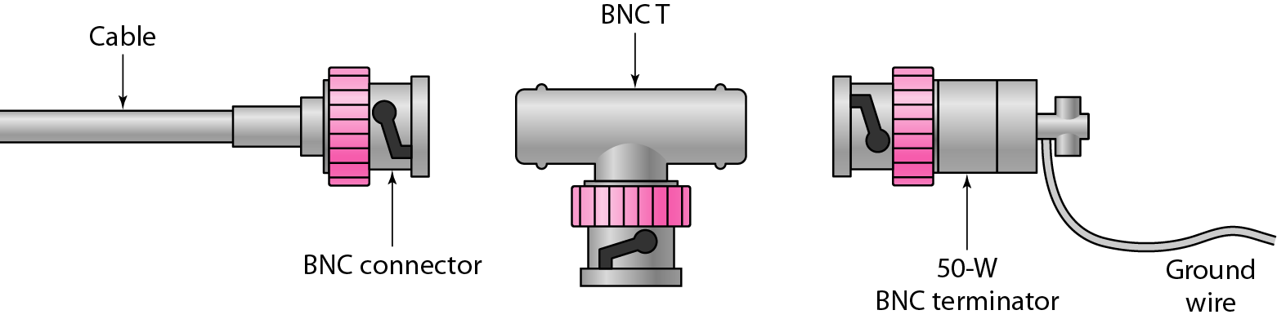
Coaxial Cable Connector
To connect coaxial cable to devices, we need coaxial connectors. The most common type of connector used today is the Bayone-Neill-Concelman (BNC) connector.
Three popular types of these connectors:
BNC connector
BNC T connector
BNC terminator

Slide 14
Coaxial Cable Connector
The BNC connector is used to connect the end of the cable to a device, such as a TV set.
The BNC T connector is used in Ethernet networks to branch out to a connection to a computer or other device.
The BNC terminator is used at the end of the cable to prevent the reflection of the signal.

Slide 15
Nature of Light
Light travels in a straight line as long as it is moving through a single uniform substance.
If a ray of light traveling through one substance suddenly enters another substance (of a different density), the ray changes direction.

Slide 16
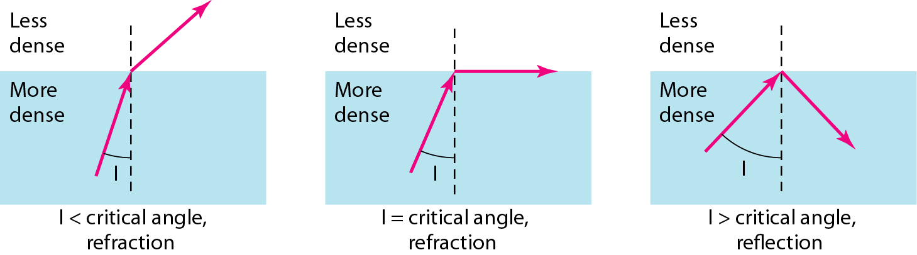
Nature of Light
A ray of light changes direction when going from a more dense to a less dense substance.
If the angle of incidence I (the angle the ray makes with the line perpendicular to the interface between the two substances) is less than the critical angle, the ray refracts and moves closer to the surface.
If the angle of incidence is equal to the critical angle, the light bends along the interface.
If the angle is greater than the critical angle, the ray reflects (makes a turn) and travels again in the denser substance.

Slide 17
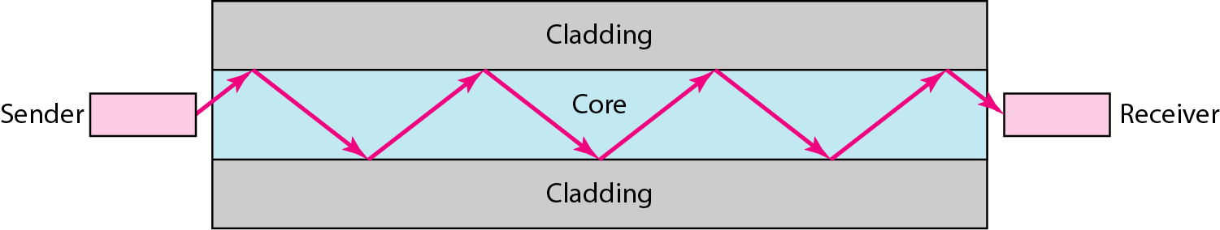
Fiber Optic Cable
A fiber-optic cable is made of glass or plastic and transmits signals in the form of light.
A glass or plastic core (which has more density) is surrounded by a cladding of less dense glass or plastic.
The difference in density of the two materials must be such that a beam of light moving through the core is reflected off the cladding instead of being refracted into it.

Slide 18
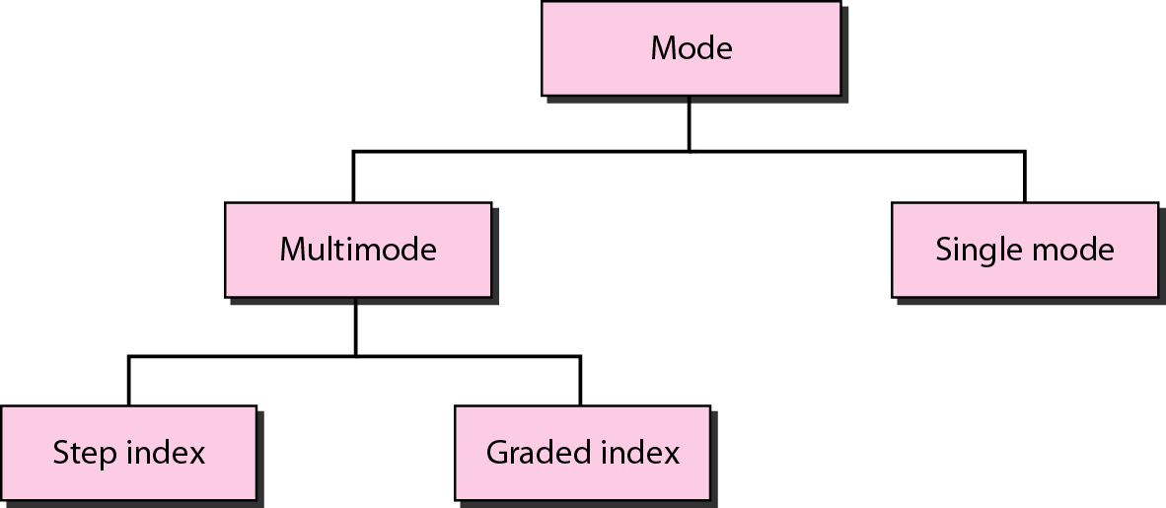
Propagation Modes of Optical Channels

Slide 19
Multimode
Multimode is so named because multiple beams from a light source move through the core in different paths.

Slide 20
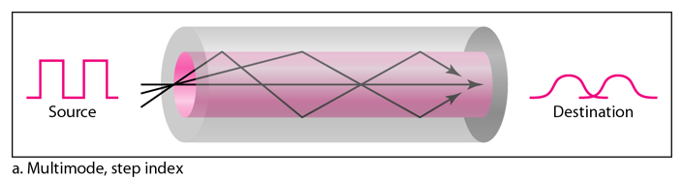
Multimode Step Index
Multimode step-index fiber, the density of the core remains constant from the center to the edges.
A beam of light moves through this constant density in a straight line until it reaches the interface of the core and the cladding.
At the interface, there is an abrupt change due to a lower density; this alters the angle of the beam's motion.
The term step index refers to the suddenness of this change, which contributes to the distortion of the signal as it passes through the fiber.

Slide 21
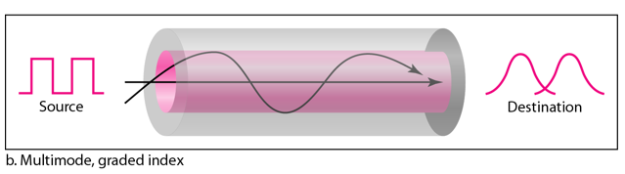
Multimode Graded Index
A second type of fiber, called multimode graded-index fiber, decreases this distortion of the signal through the cable.
The word index here refers to the index of refraction. As we saw above, the index of refraction is related to density.
A graded-index fiber, therefore, is one with varying densities.
Density is highest at the center of the core and decreases gradually to its lowest at the edge.

Slide 22
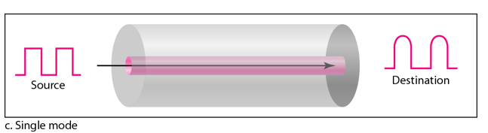
Single Mode
Single-mode uses step-index fiber and a highly focused source of light that limits beams to a small range of angles, all close to the horizontal.
It has substantially low density (index of refraction).
The decrease in density results in a critical angle that is close enough to 90° to make the propagation of beams almost horizontal.
In this case, propagation of different beams is almost identical, and delays are negligible.
All the beams arrive at the destination "together" and can be recombined with little distortion to the signal.

Slide 23
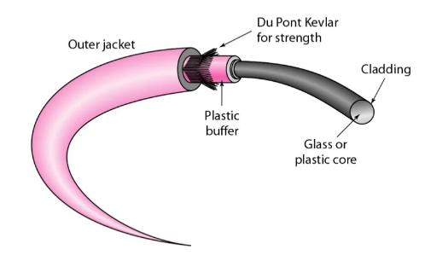
Cable Composition
The outer jacket is made of either PVC or Teflon.
Inside the jacket are Kevlar strands to strengthen the cable.
Kevlar is a strong material used in the fabrication of bulletproof vests.
Below the Kevlar is another plastic coating to cushion the fiber.
The fiber is at the center of the cable, and it consists of cladding and core.

Slide 24
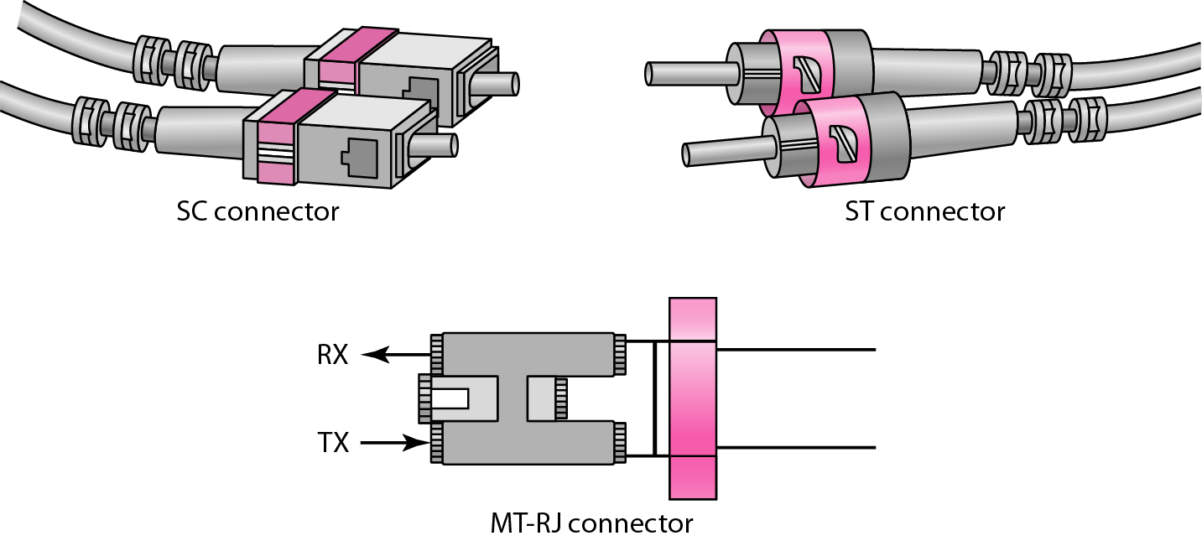
Cable Connectors
The subscriber channel (SC) connector is used for cable TV. It uses a push/pull locking system.
The straight-tip (ST) connector is used for connecting cable to networking devices. It uses a bayonet locking system and is more reliable than SC.
MT-RJ is a connector that is the same size as RJ45.

Slide 25
Fiber Optic Cable
Advantages
Higher bandwidth
Less signal attenuation
Immunity to electromagnetic interference
Resistive to corrosive materials
Light weight
Greater immunity to tapping
Disadvantages
Difficult to maintain and install
High cost
Unidirectional, will need another fiber if we want bidirectional communication.

Slide 26
Unguided Media/Wireless
Unguided media transport electromagnetic waves without using a physical conductor.
This type of communication is often referred to as wireless communication.
Signals are normally broadcast through free space and thus are available to anyone who has a device capable of receiving them.

Slide 27
Propagation Modes
Unguided signals can travel from the source to destination in several ways:
Ground propagation
Sky propagation
Line-of-sight propagation

Slide 28
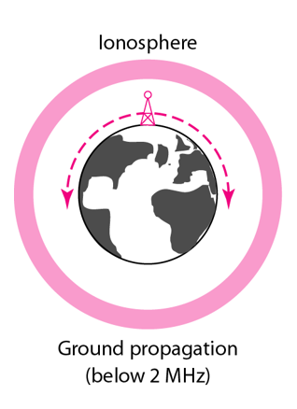
Propagation Modes
Ground propagation
Radio waves travel through the lowest portion of the atmosphere, hugging the earth.
These low-frequency signals emanate in all directions from the transmitting antenna and follow the curvature of the planet.
Distance depends on the amount of power in the signal: The greater the power, the greater the distance.

Slide 29
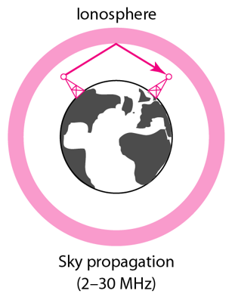
Propagation Modes
Sky propagation
Higher-frequency radio waves radiate upward into the ionosphere where they are reflected back to earth. This type of transmission allows for greater distances with lower output power.

Slide 30
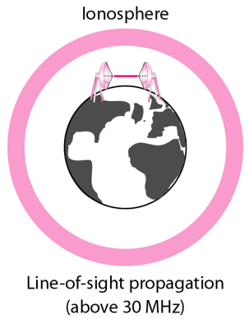
Propagation Modes
Line of Sight propagation
Very high-frequency signals are transmitted in straight lines directly from antenna to antenna.
Antennas must be directional, facing each other and either tall enough or close enough together not to be affected by the curvature of the earth.

Slide 31
Propagation Modes
Line of Sight propagation
Very high-frequency signals are transmitted in straight lines directly from antenna to antenna.
Antennas must be directional, facing each other and either tall enough or close enough together not to be affected by the curvature of the earth.

Slide 32
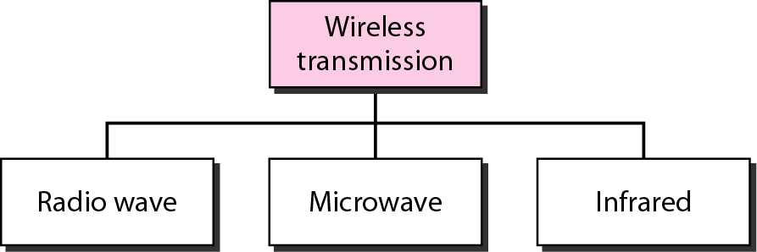
Wireless Communication

Slide 33
Wireless Communication
Radio waves
It has frequency between 3KHz to 1 GHz.
Radio waves are omnidirectional.
When an antenna transmits radio waves, they are propagated in all directions.
This means that the sending and receiving antennas do not have to be aligned.
The omnidirectional property has a disadvantage and radio waves transmitted by one antenna are susceptible to interference by another antenna that may send signals using the same frequency or band.
Radio waves are propagate in the sky mode, can travel long distances.
This makes radio waves a good candidate for long distance broadcasting such as AM radio.
Radio waves, particularly those of low and medium frequencies, can penetrate walls.

Slide 34
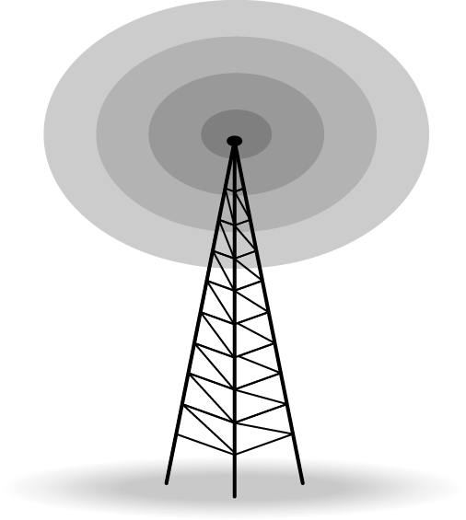
Wireless Communication
Applications of Radio Waves
The omnidirectional characteristics of radio waves make them useful for multicasting, in which there is one sender but many receivers.
AM and FM radio, television, maritime radio, cordless phones, and paging are examples of multicasting.

Slide 35
Wireless Communication
Micro Waves
Electromagnetic waves having frequencies between 1 and 300 GHz.
Microwaves are unidirectional.
When an antenna transmits microwave waves, they can be narrowly focused.
This means that the sending and receiving antennas need to be aligned.
Microwave propagation is line-of-sight.
Very high-frequency microwaves cannot penetrate walls. This characteristic can be a disadvantage if receivers are inside buildings.

Slide 36
Wireless Communication
Micro Waves
Microwaves need unidirectional antennas that send out signals in one direction. Two types of antennas are used for microwave communications: the parabolic dish antenna and the Horn antenna.

Slide 37
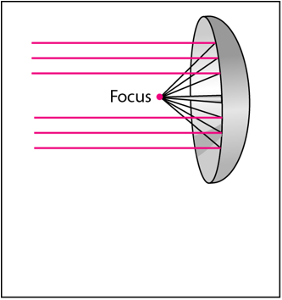
Wireless Communication
Parabolic Dish Antenna
A parabolic dish antenna is based on the geometry of a parabola: Every line parallel to the line of symmetry reflects off the curve at angles such that all the lines intersect in a common point called the focus.
The parabolic dish works as a funnel, catching a wide range of waves and directing them to a common point.

Slide 38
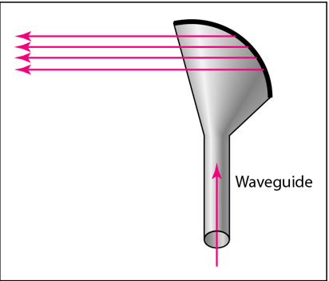
Wireless Communication
Horn Antenna

Slide 39
Wireless Communication
Application of Micro waves
Microwaves are used for unicast communication such as cellular telephones, satellite networks, and wireless LANs.

Slide 40
Wireless Communication
Infrared
Infrared waves, with frequencies from 300 GHz to 400 THz can be used for short-range communication.
Infrared waves, having high frequencies, cannot penetrate walls.
Applications
Infrared signals can be used for short-range communication in a closed area using line-of-sight propagation.

